Slide 1
The EAC Rapidly Deployable Experts (RDE) System
Ayub Manya

Slide 2
Outline of presentation
Introduction
Actors in RDE
Getting started with RDE
Signing up or applying to the pool of experts

Slide 3
Introduction
There are many disease outbreaks globally
Availability of skilled staff, political structures, and timely communication determine the rate of the spread of outbreaks
Time too is important; the faster action is taken, the more likely an outbreak will be contained quickly
This calls for adequate emergency preparedness by having a pool of rapidly deployable experts
This system was developed to manage the EAC pool of rapidly deployable experts

Slide 4
Introduction
RDE is web-based, hosted at a central server at EAC
Supports multiple operating systems - Windows, UNIX, LINUX
Supports multi-language menu (English, French & Swahili)
Utilizes open standards for data exchange; interoperability
Can exchange data with other systems through an Application Program Interface (API)
The system is extensible with new functionalities

Slide 5
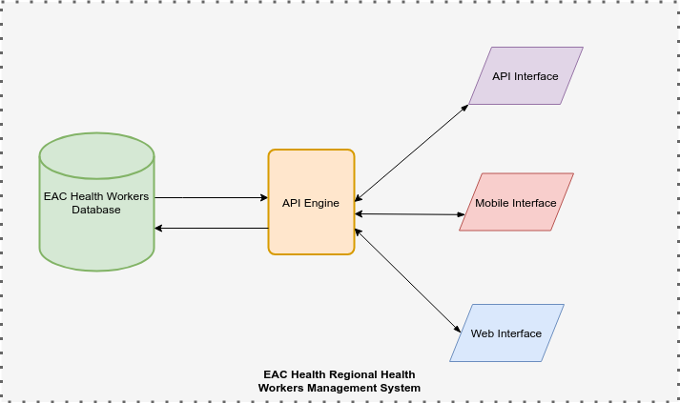

Slide 6
Actors in RDE
The Rapidly Deployable Experts:
Apply to be included in the regional pool
Track the application process, payment and deployment
View the deployment requests/notifications
Accept or decline deployment requests
View/Update their profiles
Submit mission reports and feedback

Slide 7
Actors in RDE cont.
The EAC level Users:
Review and approve the expert enrolment applications
View submitted mission reports from the experts
Partner State Level Users:
View applicants from their states and make any recommendations
View the reports of the deployed pool
the EAC level Content/ICT manager
Add/manage application contents like qualifications, competencies, New Partner states,
Configure the system metadata (e.g. specializations) and workflows
Server management

Slide 8
Feature | Particulars
User Management | RDE allows self-registration. Once staff has been registered, an account is created for them and a confirmation email sent to them for subsequent self-management of information in their profile
Open Source Platform | RDE is designed on an open-source platform, with no recurring licensing fee, which makes the solution sustainable in the long term
Interoperable | RDE is built with the Fast Healthcare Interoperability Resources (FHIR) standard that allows for sharing of data between itself and other systems through APIs
System Validation | The system is built with data entry validation to ensure the completion, validity and integrity of data
System and Data Security | In addition to restricted user accounts that allow users to enter or view specific datasets, data in RDE is encrypted to ensure the privacy and confidentiality of human resource data
Real-time reports | RDE is built with real-time reports and summaries to facilitate decision making

Slide 9
Getting started with RDE cont.
The following are the steps for opening the RDE
Step 1: Open your web browser
Step 2: Input the URL http://196.41.38.246/ in the address field and the RDE login screen will appear
Step 3: Either log in (with credentials) or sign up to get registered

Slide 10
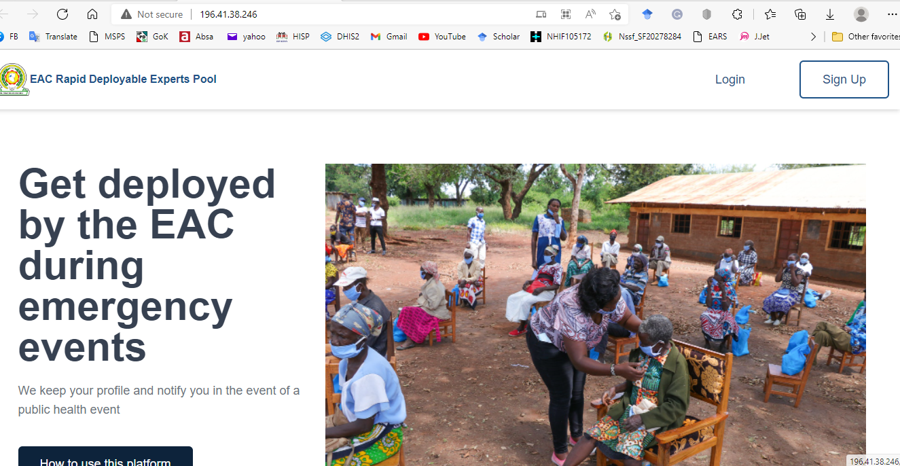

Slide 11
Signing up or applying to be in the pool
The experts will self-register through a customized data-entry screen and be able to attach their Curriculum Vitae (CV)
The EAC level users will be able to download the CVs and the summary information for each expert
After registration, the system sends a confirmation email
The expert may log in to view and track their application process, deployment and payment.

Slide 12
Thank you!

